Slide 1

Scams awareness
Detecting and avoiding general scams

Slide 2
Meet the team
Ali Bahaloo
Associate Director, Software Development @ Bounteous
Kimia Yeganeh - P.Eng, CEM, CMVP, CSPO
Business/Product Manager @ PUMA

Slide 3

Meet the team
Software Consulting & Technical Advising from ideation to launch
Business Development
Software Development
https://ahuratech.ca/

Slide 4
Today we’ll cover
Common Scams You’ll See Today
Real examples: government, bank, tech support, delivery, and family scams
How to Spot Red Flags Quickly
Simple warning signs you can recognize in seconds
What to Do If You’ve Been Scammed
Immediate steps to protect your money and accounts
How to Reduce Your Risk Going Forward
Practical tools: privacy habits, 2FA, phone settings, and data protection

Slide 5
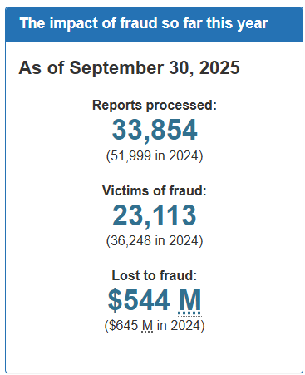
Scam Losses & Prevalence (Canada, 2024)
🇨🇦 ≈ $645 million - total losses from fraud and scams reported in 2024.
51,999 - number of scam-related incidents reported to CAFC in 2024.
According to surveys: only 5 - 10% of scam victims file a report: actual losses likely much higher.
1 in 5 Canadians (17 %) lost money to fraud last year; median loss ≈ $2,013.
More than $310 million lost specifically to frauds involving investments (e.g. fake investment pitches, crypto scams).
Losses due to fraud have nearly tripled since 2020, showing a steep upward trend as technology advances (e.g. AI)
Source: Canadian Anti-Fraud Centre

Slide 6
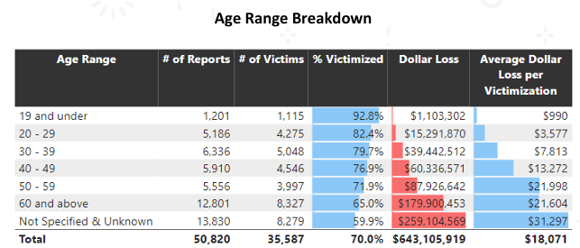
Loss reports by age
AFC Annual Statistics Report 2024 – source
Reporting shows that individuals under the aged 50 are more likely to be victimized by fraud and that those over the age of 50 lose more money on average per fraud. The total amount lost by seniors (60 and above) makes up 27.9% of the overall dollar loss reported to CAFC.

Slide 7



How scammers operate
Psychological Tricks
Urgency
Fear
Authority
Isolation
Confusion
Why It Feels Personal
Caller ID spoofing
Social engineering
Your digital footprint
Customized scripts
Using AI to impersonate relatives voice
How They Find You (explained later)
Data breaches
Data Brokers
Public social media
Victim lists

Slide 8
Most Common Scams Right Now
Government impersonation
Bank fraud department scams
Tech support scams
Family / emergency scams
Gift card scams
Fake package delivery
Utility & service provider scams
Online shopping scams
Romance scams
Subscription renewal scams

Slide 9
Next
Let’s look at some example scenarios, and identify red flags

Slide 10
Government Impersonation (CRA / IRS / Immigration)
Scenario:
“This is the Canada Revenue Agency. You owe back taxes. If payment is not made today, legal action will begin. Press 1 to speak to an agent.”
Why It Feels Convincing
Uses authority and fear
Creates urgency
Sounds official and serious
🚩 Red Flags
Threats of arrest or immediate legal action
Requests for payment via gift cards, crypto, or e-transfer
Pressure to act immediately
Caller asks for SIN or banking info
✅ How to Spot It
CRA never threatens arrest over the phone
CRA never demands gift cards or crypto
Hang up and call CRA using an official number

Slide 11
Bank Fraud Department Scam
Scenario:
“We detected suspicious activity on your account. Please confirm your PIN code.”
Why It Feels Convincing
Caller ID looks like your bank
Uses real banking language
They already know your name
🚩 Red Flags
Asking for one-time passcodes
Asking for PINs or full card numbers
Pressure to “act now”
Staying on the line while you log in
✅ How to Spot It
Banks never ask for verification codes
Hang up and call the number on the back of your card
If they insist you stay on the line → it’s a scam

Slide 12
Tech Support Scam
Scenario:
A pop-up says: “Virus detected. Call Microsoft Support immediately.” Once called, the agent usually askes for “remote connection” to fix the issue.
Why It Feels Convincing
Uses well-known brand names (e.g. Microsoft, Apple)
Looks urgent and technical
Fear of losing data
🚩 Red Flags
Pop-ups with phone numbers
Requests to install remote software
Requests for payment to “fix” the issue
✅ How to Spot It
Microsoft and Apple do not call you
Close the browser - do not call the number
Restart your computer if needed
Ask a trusted person before acting

Slide 13
Family / Emergency Scam
Scenario:
“Grandma, I’m in trouble. Please send me some money and don’t tell anyone.”
Why It Feels Convincing
Emotional manipulation
Sounds like a loved one
Requests secrecy
🚩 Red Flags
Urgent request for money
Request to keep it secret
Payment via gift cards or wire transfer
✅ How to Spot It
Pause and ask a personal question
Call another family member to verify
Never act on panic alone

Slide 14
Gift Card Scam
Scenario:
“Payment must be made using Apple or Google gift cards.” Usually in relationship with other scams such as Tech Support, Taxes, etc
Why It Feels Convincing
Framed as “fast” or “secure”
Comes from authority figures
🚩 Red Flags
Any request for gift cards
Requests to share gift card codes
Claims gift cards are “official payment”
✅ How to Spot It
Legitimate organizations never use gift cards
Once codes are shared, money is gone
This is always a scam

Slide 15
Fake Package Delivery
Scenario:
“Your package couldn’t be delivered. Click here to reschedule.” Usually followed by asking for payment and/or personal information.
Why It Feels Convincing
Many people expect packages
Looks routine and harmless
🚩 Red Flags
Unknown sender or odd link
Requests for payment or personal info
Spelling or grammar errors
✅ How to Spot It
Don’t click links
Go directly to the delivery company’s website or call them
Real companies don’t ask for payment by text

Slide 16
Utility / Service Provider Scam
Scenario:
“Your power will be shut off today unless you pay now.”
Why It Feels Convincing
Fear of losing essential services
Uses real utility names
🚩 Red Flags
Immediate shutoff threats
Demands for unusual payment methods
Calls outside normal business hours
✅ How to Spot It
Utilities give written notice first in advance (and multiple times before shutting off any services)
Call the utility using your bill
Never pay under pressure

Slide 17
Online Shopping / Marketplace Scam
Scenario:
Seller asks you to pay via e-transfer/Gift Cards outside the platform.
Why It Feels Convincing
Good price
Friendly communication
Fake reviews
🚩 Red Flags
Requests to leave the platform
No buyer protection
Pressure to pay quickly
✅ How to Spot It
Stay within the platform
Avoid deals that feel “too good”
Use secure payment methods (e.g. PayPal)

Slide 18
Romance Scam
Scenario:
Online partner asks for money after building trust. Someone that you’ve met online (and never in person) builds trust and eventually asks for money (usually followed by an excuse due to some emergency)
Why It Feels Convincing
Long-term emotional connection
Daily communication
🚩 Red Flags
Avoids video calls
Requests for money, crypto, or gift cards
Claims emergencies abroad
✅ How to Spot It
Never send money to someone you haven’t met
Discuss with a trusted friend
Scammers avoid real-world meetings

Slide 19
Subscription Renewal Scam
Scenario:
Received an invoice: “Your Norton subscription will renew for $499 today.”
Why It Feels Convincing
Familiar brand names
Fear of unexpected charges
🚩 Red Flags
Unexpected invoices
Phone numbers to “cancel”
Requests for remote access
✅ How to Spot It
Check subscriptions directly on official websites
Do not call numbers in emails
When in doubt, delete the email

Slide 20
Golden Rule
Pause. Verify. Never act under pressure.

Slide 21
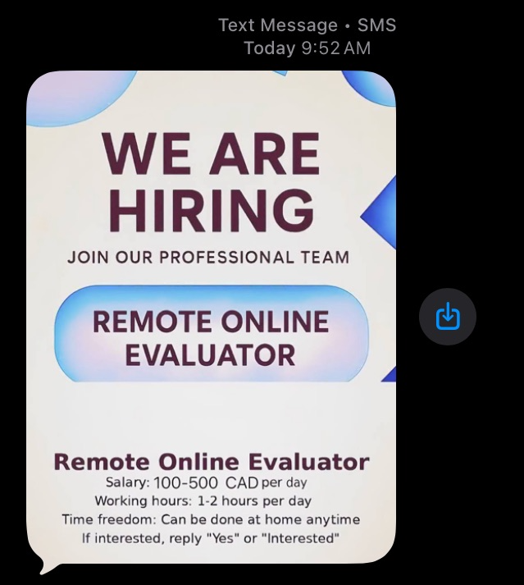
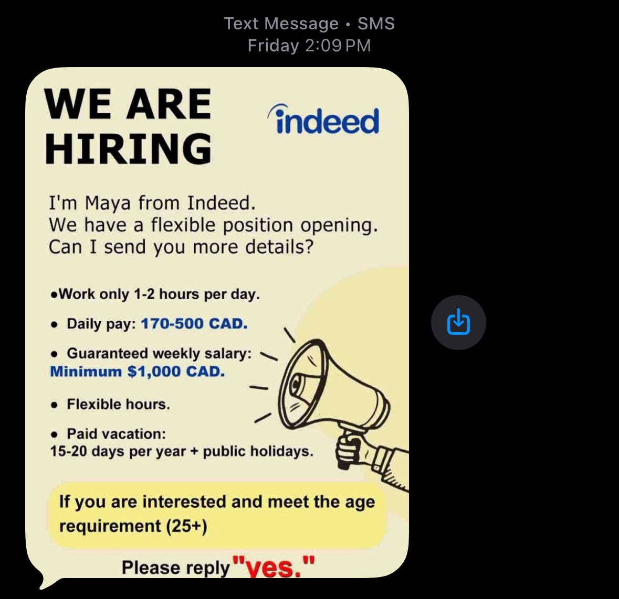
Real-life Examples

Slide 22
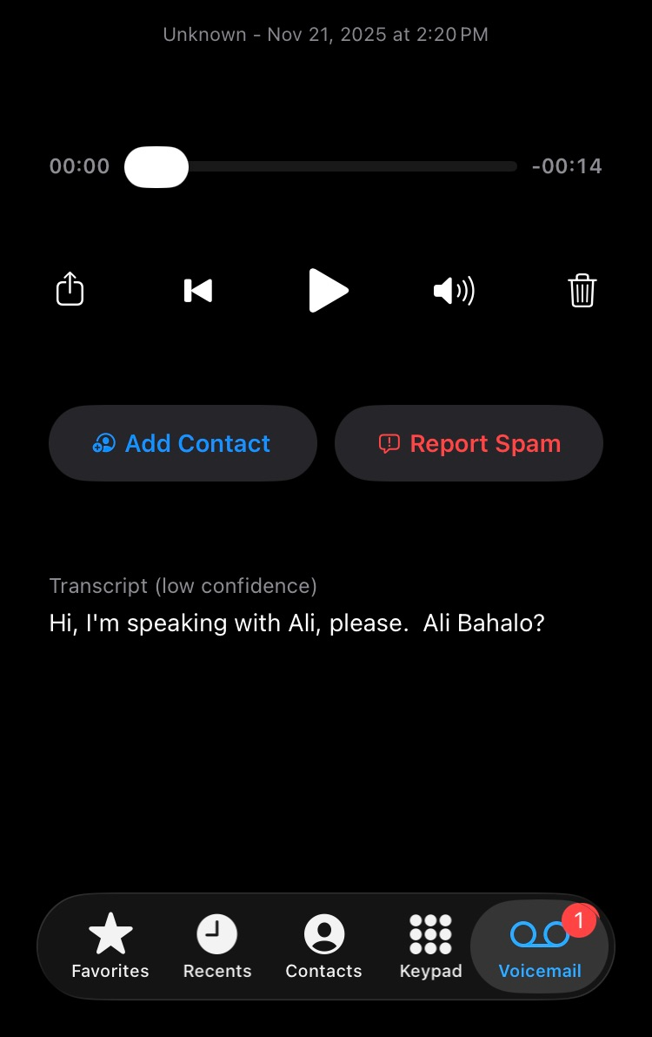
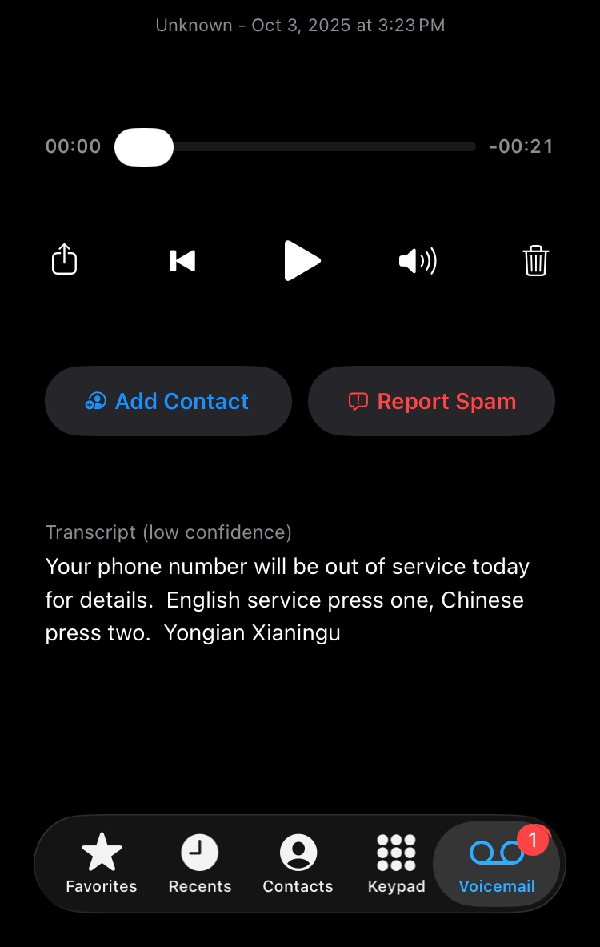
Real-life Examples

Slide 23
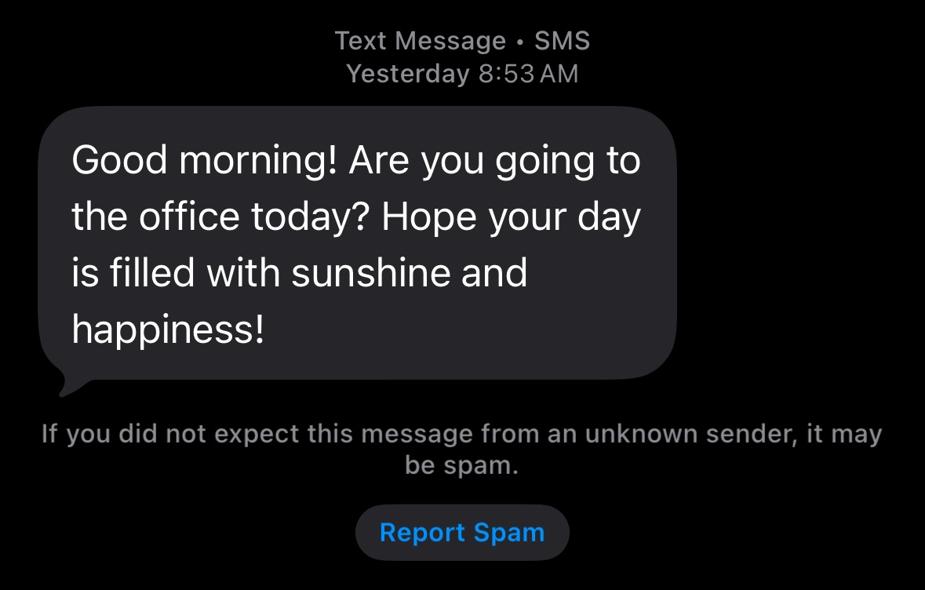
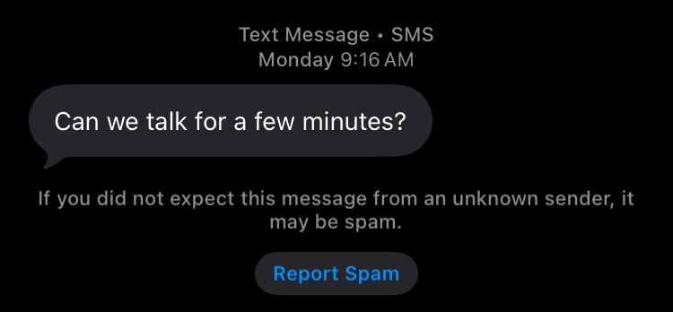
Real-life Examples

Slide 24
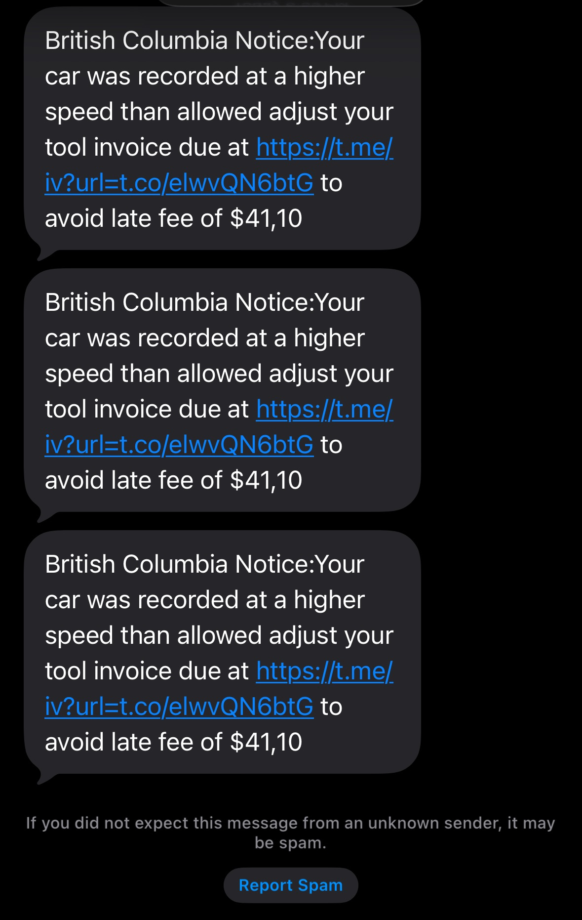
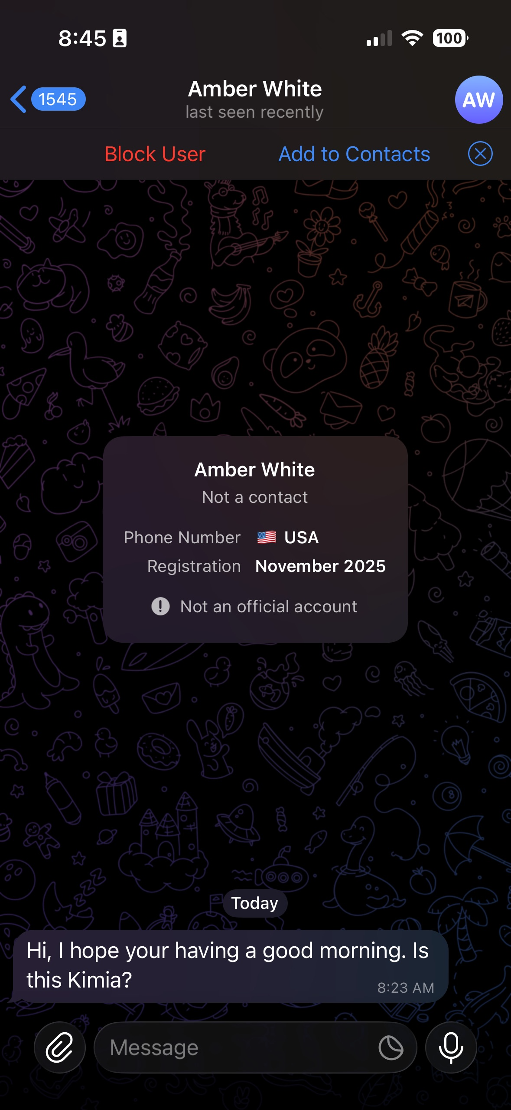
Real-life Examples

Slide 25
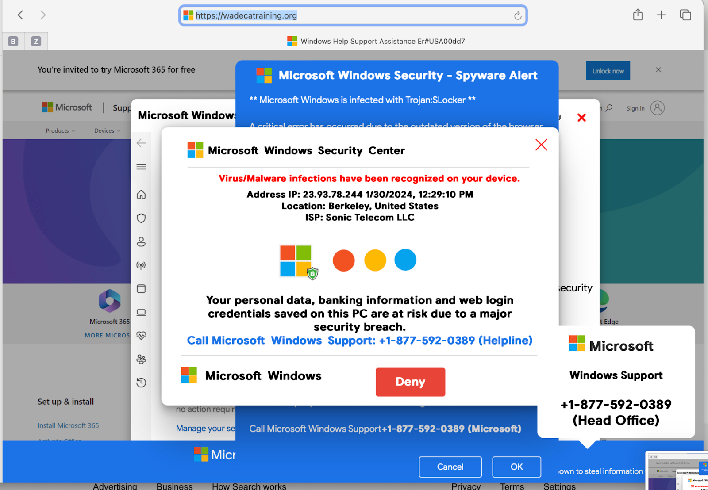
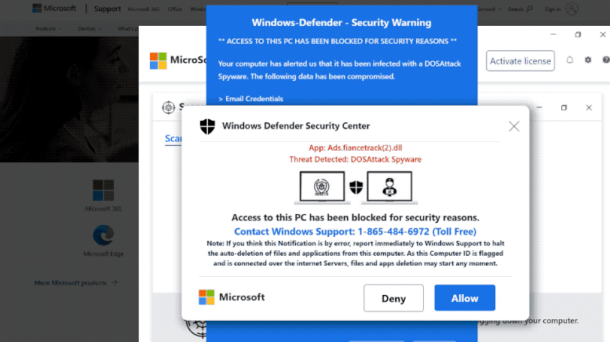
Real-life Examples

Slide 26
If You’ve Been Scammed: What to Do
1. Stop
End the call or message
No more payments or replies
2. Secure
If made a payment; call your bank
If you think your account has been compromised;: change your password immediately. If password is already changed and you cannot login, reset it.
If you have an active remote access connection, close it (restart/shutdown computer)
3. Monitor & Talk
Watch accounts
Warn family
Ask for help
4. Report
Canadian Anti-Fraud Centre
Local police (if needed)
Notes:
✅ What to Do If You’ve Been Scammed
(Key message to repeat out loud: “This can happen to anyone. Acting quickly helps.”)
Step 1: Stop the Interaction Immediately
Hang up the phone
Do not reply to messages or emails
Do not send any more money
Do not click any more links
Important: Scammers often try to re-contact you. Ignoring them is critical.
Step 2: Secure Your Accounts
What you do depends on what was shared:
If money was sent
Contact your bank or credit card company immediately
Ask to freeze transactions or reverse payments
Time matters — earlier action increases chances of recovery
If personal information was shared
Change passwords (email, banking, shopping)
Enable two-factor authentication
Watch for suspicious activity
If remote access was given
Disconnect your device from the internet
Turn off or remove remote software
Get technical help to check your device
Step 3: Report the Scam
Reporting helps protect others and may help you recover losses.
🇨🇦 In Canada
Canadian Anti-Fraud Centre (CAFC)
Report online or by phone
Local police (especially if large amounts were lost)
Why reporting matters
Helps authorities track scam patterns
Prevents future victims
Creates a record if identity theft occurs later
Step 4: Monitor & Protect Going Forward
Watch bank and credit card statements closely
Check your credit report
Be cautious of “recovery scams”
Scammers pretending to help you recover lost money
Step 5: Talk to Someone
Tell a family member or trusted friend
Talk to your bank or service provider
Do not feel embarrassed — scams are designed to trick people
Silence helps scammers. Talking helps victims.

Slide 27
Where Scammers Get Your Information
Data Brokers
  Data brokers are companies that collect, buy, and sell personal information.
  They may gather: Personal information (Name, Age, Address, etc), Contact Info (Phone #, Email), Shopping Habits, Online Activities, etc
  What Data Brokers Do
    Combine data from many sources
    Build detailed personal profiles
    Sell this data to advertisers - and sometimes to bad actors
Most people don’t know these companies exist, but operate legally in many countries with limited oversight.
Data Breaches
  Companies get hacked
  Customer databases are stolen
  Email addresses, passwords, and phone numbers leak
  Data is resold on underground markets
Public Information
  Information you share publicly can be collected automatically (web scarping):
  Social media posts
  Online profiles
  Comments, forums, photos

Slide 28
How to Reduce Data Exposure (Practical Tips)
Be Careful What You Share Online
Avoid posting: Full birthdates, Phone numbers, Addresses, Travel plans
Be cautious with: Quizzes and “fun surveys”, Contests and giveaways
Lock Down Important Accounts
Use strong, unique passwords
Turn on two-factor authentication (2FA)
Secure your email first - it controls password resets
Limit Data Collection
Say no to unnecessary app permissions
Avoid free apps that ask for excessive access
Read prompts before clicking “Allow”
Remove Your Data from Data Brokers
You can directly ask data brokers to remove your data and they are LEGALLY obligated to do so, but there are too many of them!
There are 3rd party companies that do this on your behalf.
Incogni - https://incogni.com/
  Automatically requests removal of your data from data broker websites
  Continuously monitors and re-submits removal requests
  Focused specifically on data broker cleanup
Aura - https://www.aura.com/
  Identity theft protection
  Credit and identity monitoring
  Scam, fraud, and privacy alerts
  Some plans include data broker removal

Slide 29
Password Managers
Why Password Managers Matter
Most breaches happen because passwords are reused
If one site is compromised, reused passwords unlock others
A password manager lets you use strong, unique passwords everywhere
What a Password Manager Does
Creates unique passwords for each account
Stores them securely in one place
Automatically fills them in when you sign in
You only need to remember one strong master password
Options Available
Third-party password managers exist and are widely used
Modern browsers already include this feature, such as:
  Google Chrome
  Microsoft Edge
These built-in managers can:
Save passwords
Generate strong passwords
Sync securely across your devices

Slide 30
Two-Factor Authentication (2FA)
What Is 2FA? (Plain Language)
It usually means:
  Something you know → your password
  Plus something you have → a code sent to your phone or app
Why 2FA Is So Important
Passwords get leaked or stolen
Scammers buy passwords from data breaches
2FA blocks access even if the password is correct
Common Types of 2FA
Text message code (SMS)
Authenticator app (Google Authenticator, Microsoft Authenticator)
Push notification (“Approve sign-in?”)
Where You Should Enable 2FA First
Email account (most important)
Bank & financial accounts (if they support)
Apple ID / Google account
Social media
Shopping accounts (Amazon, etc.)

Slide 31
🚩 Important 2FA Safety Tip
Never share a one-time code with anyone
Banks and companies will never ask for it
If someone asks → it’s a scam

Slide 32
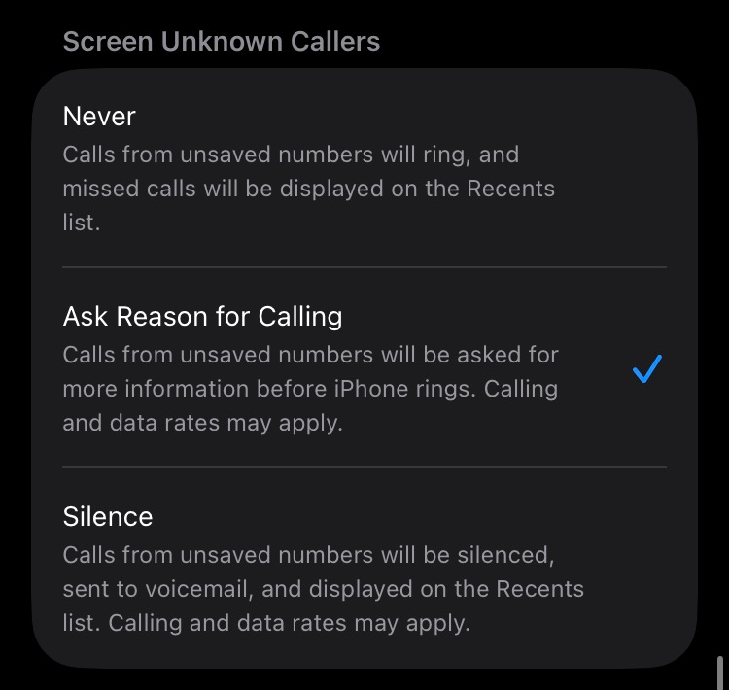
Reduce Scam Calls on iPhone: Silence Unknown Callers
What happens
Known callers (from your contact list) are bypassed automatically but unknown callers are asked why they are calling before your phone rings
Your phone rings only if the caller provides a reason
You see the reason on your screen before answering
Why this works
Legitimate callers can explain themselves
Most scammers hang up or fail this step
You regain control before answering

Slide 33
Reduce Scam Calls on iPhone: Silence Unknown Callers
Why This Helps Reduce Scams
Legitimate companies leave clear voicemails
  Bank
  Doctor’s office
  Utility company
Scammers usually do not
  Many are automated robocalls
  Others hang up if voicemail answers
Reduces pressure to answer and act immediately

Slide 34
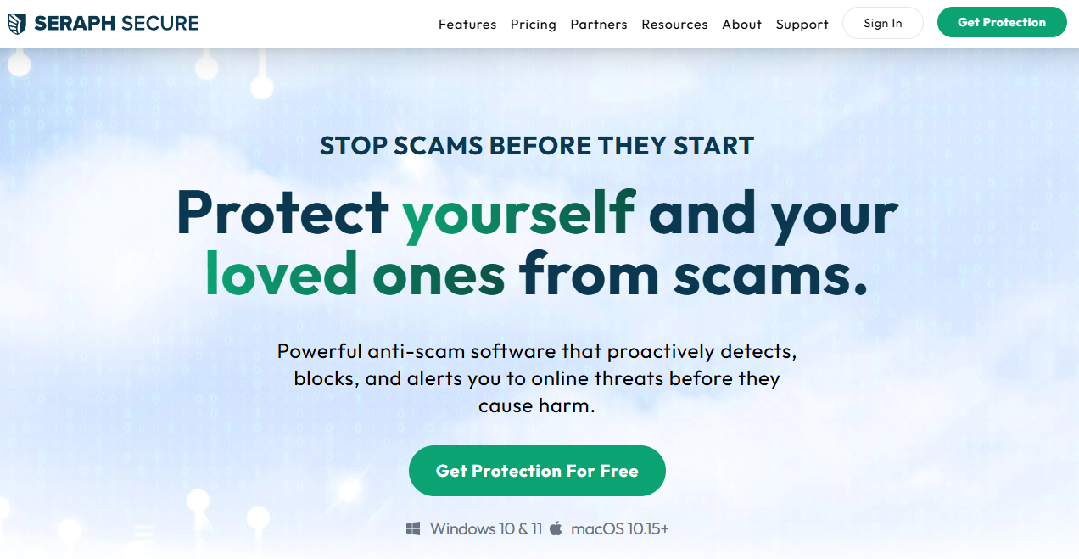
Seraph secure
Blocks remote software scammers use to gain access to your device.
Blocks thousands of known scam websites.
Detects deceptive virus pop-up messages.
Detects and blocks malicious links from emails and ads.
https://www.seraphsecure.com/

Slide 35
Be Safe Out There
Stay Informed. Stay Protected.
Scammers rely on pressure and secrecy.
You rely on knowledge and time.
When in doubt - stop and verify. Do NOT feel under pressure.
You’re Not Alone
Scams happen to smart, careful people every day.
Talking about them helps everyone stay safer.
Share the knowledge
Always report frauds/scam.

Slide 36
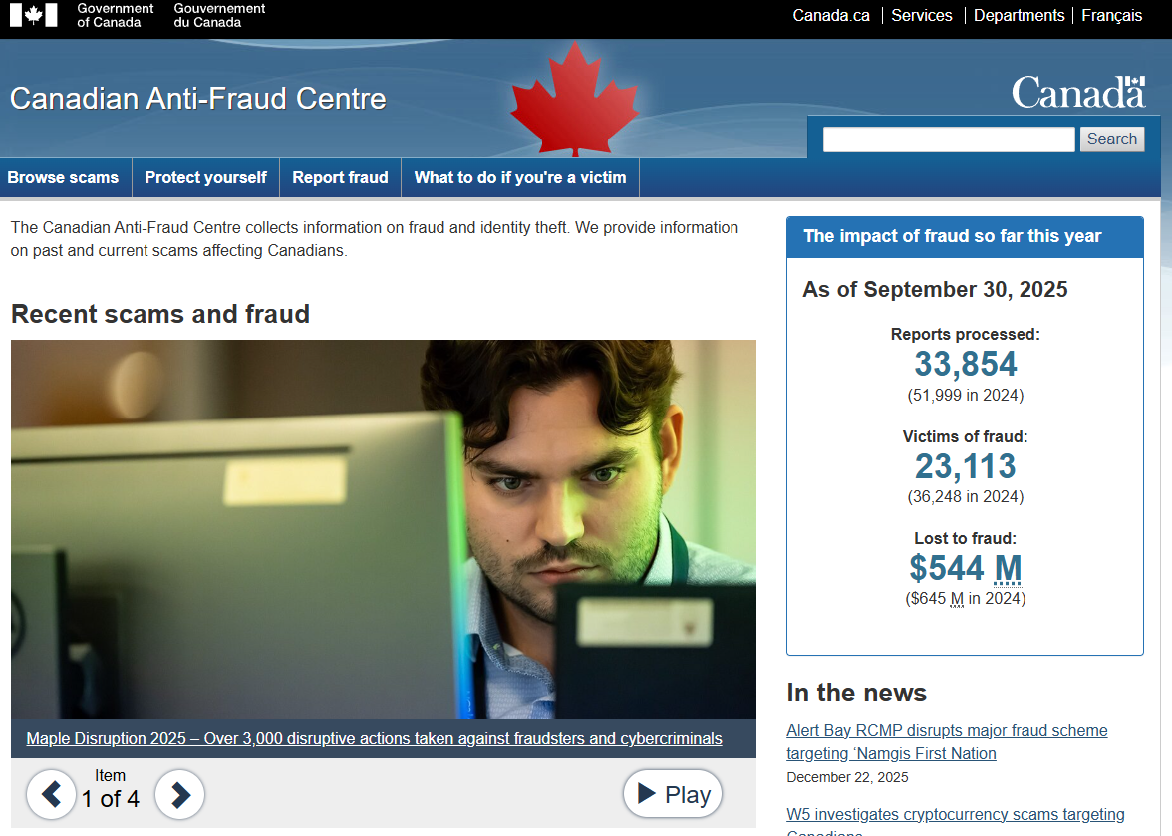
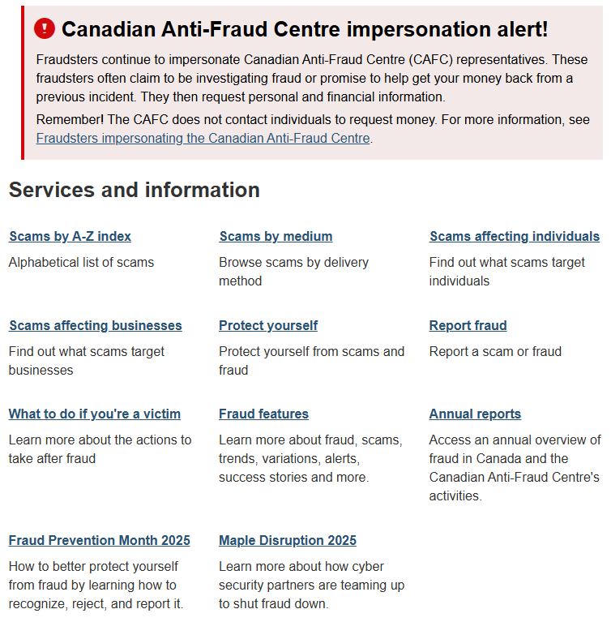
Canadian Anti-Fraud Centre
https://antifraudcentre-centreantifraude.ca/

Slide 37

Thank You
Ahuratech.ca

